Slide 1
IT Infrastructure Architecture
Infrastructure Building Blocks
and Concepts
Operating Systems – Part 2
(chapter 11)

Slide 2
Windows - introduction
Windows is a popular x86 operating system, used on PCs and servers
Because of Window’s popularity, a large collection of software is available
Microsoft provides a fairly complete stack of business solutions like SharePoint, BizTalk, SQL Server, and Exchange
They also provide a development environment (Visual Studio and the .Net framework)
Microsoft Azure cloud runs on a slimmed down version of Windows
Many organizations have a "Microsoft unless" strategy
Software is purchased from Microsoft or built using Microsoft tools, unless there is no solution from Microsoft available

Slide 3
Windows for desktops
The first version of Microsoft Windows was released in 1985
Early Windows versions ran as an application on top of MS-DOS
Windows was no real operating system
In 1990, Microsoft Windows 3.0 was the first successful Windows version
In late 1995, Microsoft released Windows 95, positioned as the new operating system for desktops
Windows 95 introduced the "start" button
Windows targeted at workstations include:
Windows XP
Windows Vista
Windows 7, 8 and 10

Slide 4
Windows for servers
In 1992, Windows NT was the first version of Windows designed to run on servers
A real operating system, not running on top of MS-DOS
Windows NT 4
Included the Windows 95 style GUI
Companies started the switch from Novell servers to Windows NT 4
Some UNIX systems were being replaced by Windows NT 4 systems
Windows 2000 introduced an implementation of LDAP directory services, called Active Directory
The server operating systems were named after the year of release: Windows server 2003, 2008, 2012, and 2016

Slide 5
Windows – Stability
While NetWare and UNIX would run for at least a year without crashing, it was not uncommon that a Windows server crashed once a day
Causes:
The need for backwards compatibility of Windows
Every version of Windows needed to be able to run all already developed software without recompilation
Windows runs on all kinds of hardware
As opposed to UNIX or Apple systems, which are designed for specific hardware
The quality of third-party drivers was not always guaranteed

Slide 6
Windows – Security
Windows security was weak
Windows was based on MS-DOS – a single user / single tasking operating system
Multi-user features and concurrently running multiple applications was built in later
Most Windows applications were not designed with multi user usage in mind
Applications had to run with the highest possible user permissions (administrator rights)
This led to the rise of viruses and worms attacking Windows

Slide 7
Windows – Security
The Trustworthy Computing Initiative
In 2002, spent several months’ full-time effort of all developers to update the Windows code base to make it more stable
As a result, today's Windows versions are reasonably stable and secure

Slide 8
Windows – Support
Windows is closed source software
Only Microsoft has access to the source code and knows how Windows works internally
Users are dependent on Microsoft for support and updates
Users must follow updates and software upgrades to get support
Extended support is sometimes possible, but at a price
This leads to frequent (and usually costly) upgrade projects

Slide 9
End user operating systems
Some operating systems are exclusively designed to be used on end user devices
Some examples:
Windows XP, Vista, Windows 7, Windows 8, and Windows 10 - Microsoft's PC operating system
Mac OS - Apple's operating system for laptops and desktops, based on BSD
Ubuntu - Linux distribution specially designed for laptops and desktops
iOS - Apple's operating system for mobile devices (iPhone, iPad, etc.), based on BSD
Android - Google's operating system for mobile devices, based on Linux

Slide 10
Special purpose operating systems
Some operating systems are created for special purposes, like:
Firewalls
Intrusion detection and prevention systems
Routers
Phones
ATM machines
Media centers
Typically based on existing operating systems
Usually based on Linux or Windows
Stripped of all unneeded features

Slide 11
Special purpose operating systems
A special type of operating system is a real-time operating system (RTOS)
Guarantee to perform tasks in a predefined amount of time
Used where handling events within a predefined time is critical
Factories
Power plants
Vehicles
Example: QNX

Slide 12
Operating system availability

Slide 13
Failover clustering
A failover cluster is:
A group of independent servers running identical operating systems (known as “nodes”)
Connected via a network
Controlled by cluster software running on the nodes
Every active application has a standby counterpart available on a passive node
It sits idle until a failover is needed
After a failover, this standby application becomes active and provides service to clients
A failover cluster provides high availability to applications
It manages each running application within a node as a package of application components, called a resource pool or an application package

Slide 14
Failover clustering
Examples of cluster software products are:
Parallel Sysplex
For IBM mainframes
HACMP
For IBM AIX UNIX
MC/Service Guard
For HP-UX UNIX
Windows Cluster Service
For Microsoft Windows
Heartbeat and Pacemaker
For Linux

Slide 15
Failover clustering
A resource pool is the single unit of failover within a cluster. It typically contains:
Application name and identifier
Start script for the application
Stop script for the application
Monitor script for the application
Continuously checks the status of the application
If the application does not work as expected, a restart or failover is initiated
Virtual IP address the application can be addressed with
Mount points for storage – the disks that must be available to the application

Slide 16
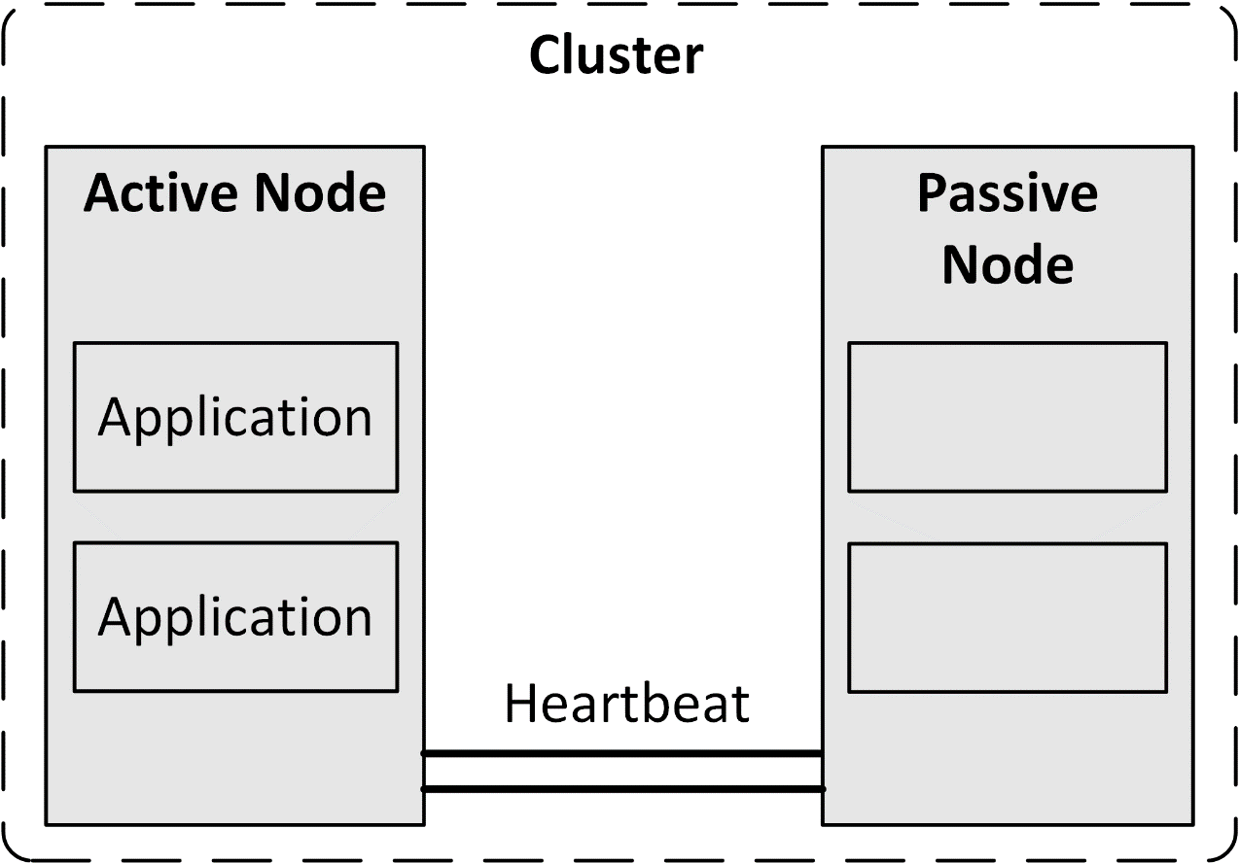
Failover clustering
A cluster network typically consists of redundant physical Ethernet connections
Carries heartbeats between all nodes in the cluster
A heartbeat allows nodes to detect the unavailability of nodes by regularly sending packets to each other's network interfaces

Slide 17
Failover clustering
All nodes are able to access data on shared storage
Every individual disk is mounted to one active application only at any given time
This usage of shared storage is also called ‘shared nothing clustering’
Distributed Lock Management (DLM) clustering:
Each cluster node can access the same resource, for instance a disk, at the same time
A lock mechanism is responsible to manage data to avoid corruption

Slide 18
Failover clustering
In case of for instance a server crash or a power outage, all applications running on that server node will not be brought down cleanly
When the applications are restarted on another node in the cluster, standard crash recovery should take place
The file system must take care of performing file system checks before mounting
The application must perform its standard recovery on startup
Application recovery in case of a failover is identical to an application startup following a server power failure

Slide 19
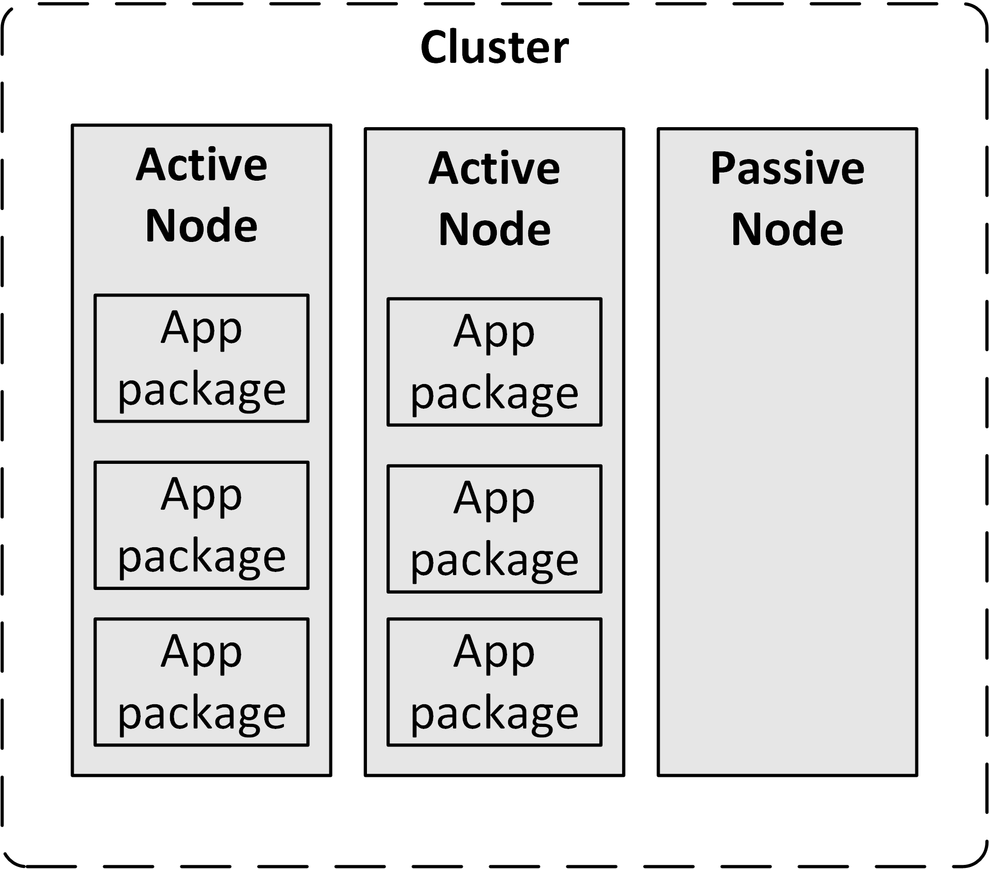
Failover clustering
A spare node could be added to a cluster to handle failovers
This is called a N+1 cluster
N represents the number of nodes with active applications
N+2 or N+3 can provide more redundancy

Slide 20
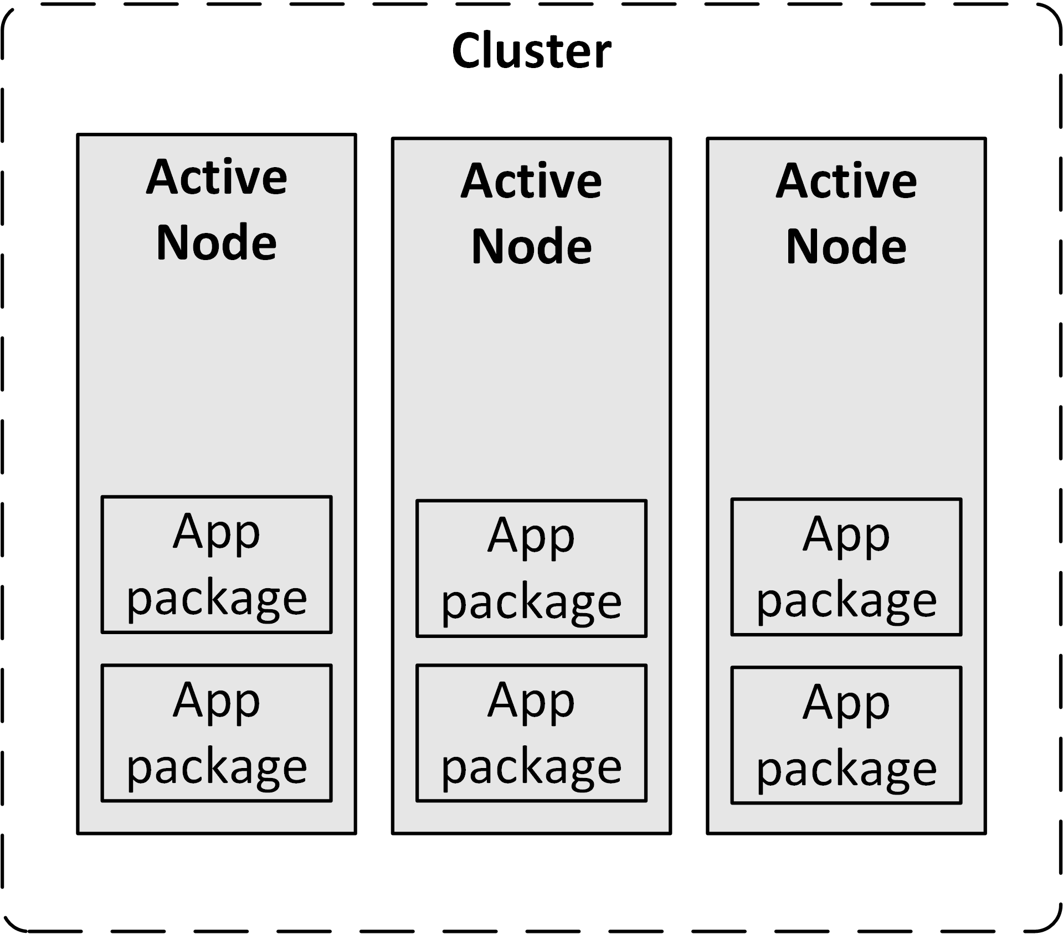
Failover clustering
An alternative is an N to N cluster
There is no spare idle node
Each node has some spare capacity

Slide 21
Failover clustering
The advantage of an N+N cluster is that the available hardware is always used
All memory and CPU cycles in the operating system can be used by all running applications
When a failover occurs, less memory and CPU cycles are available to the applications, possibly leading to some performance degradation

Slide 22
Voting and quorum disks
Most clusters contain two nodes
In a cluster with an even number of nodes, if the nodes are disconnected from each other, the status of the other nodes is unknown to each node
One of two situations occurs:
Each node decides that it has lost contact with the active cluster
Both nodes decide to stop (effectively bringing down the cluster)
Each node decides that the other node must be down
Each node decides to be the new active node in the cluster
Known as a split-brain situation

Slide 23
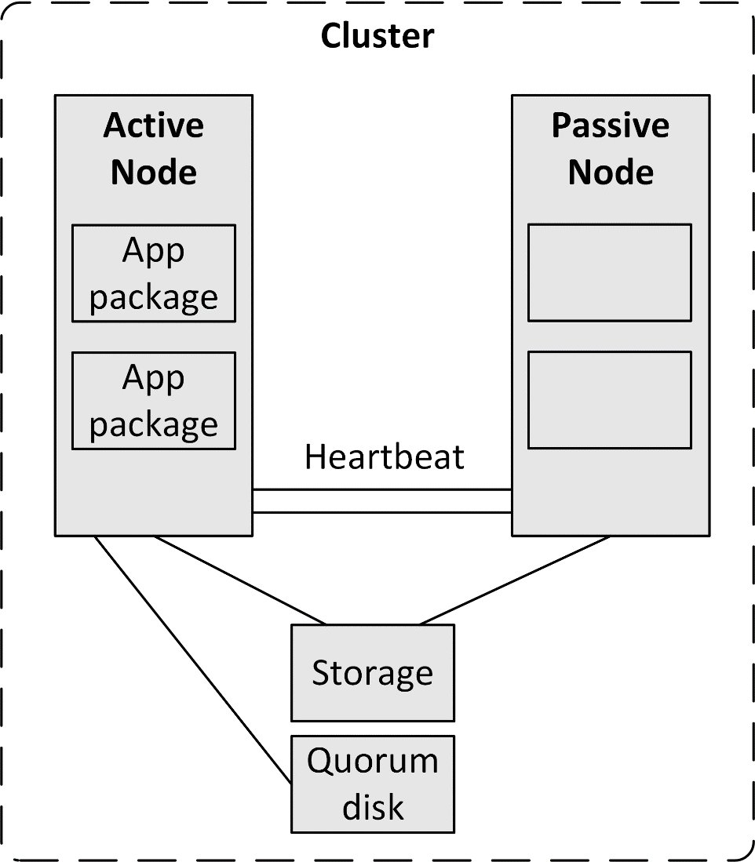
Voting and quorum disks
A voting mechanism determines which part of the cluster is faulty and which part of the cluster is working properly
In a two-node cluster there is no majority possible in a voting system
Therefore a virtual third node is used
Usually in the form of a shared disk called a quorum disk
Installed at a third location

Slide 24
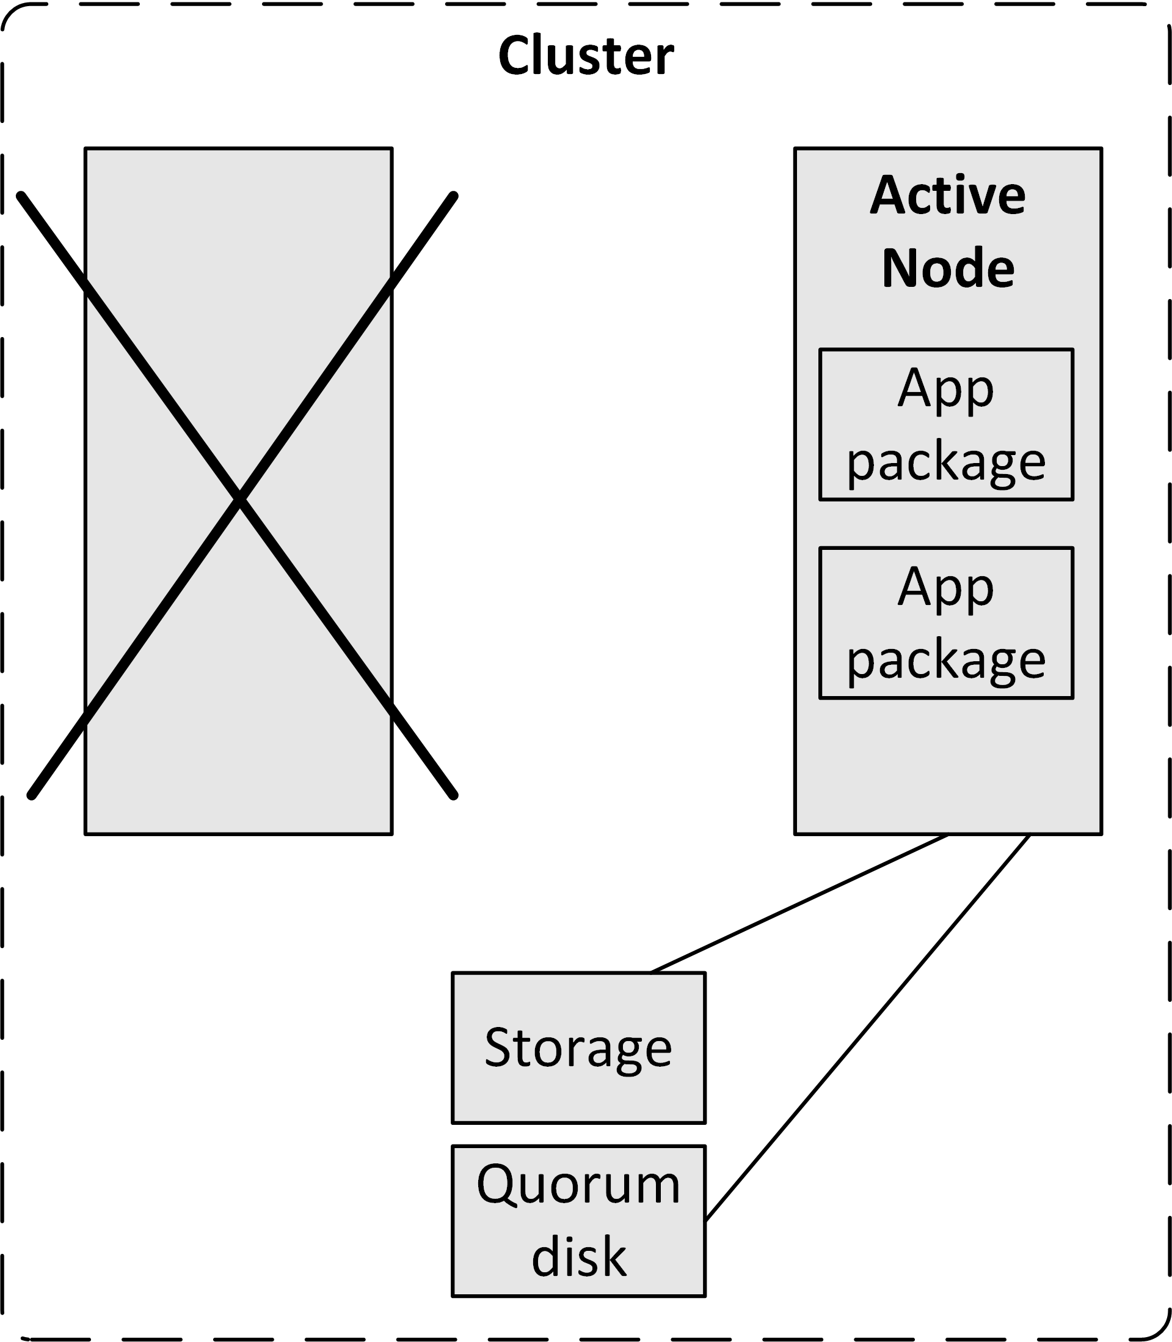
Voting and quorum disks
The quorum acts as one vote in the voting system
The quorum disk is always assigned to one (and only one) node at any time
A faulty node releases it quorum assignment automatically
The working node gets two votes: one from itself, the other from the quorum disk
The faulty node will stop working, because it has only one vote

Slide 25
Cluster-aware applications
Cluster-aware applications run active instances on multiple nodes
Examples:
Oracle RAC (Real Application Cluster)
Microsoft SQL Server Always On Failover Cluster
Microsoft Exchange Server
Enhances switch-over times in case of a failure
In case of a failure, the application does not need to be started on another node before it can service clients
Cluster-aware applications provide scalability in addition to high availability
Client requests can be distributed among multiple cluster nodes
Handle increased demand and traffic by adding additional nodes to the cluster

Slide 26
Operating system performance

Slide 27
Operating system performance
The performance of an operating system is dependent on:
The performance of the underlying hardware
The type of load generated by the applications
The configuration of the operating system itself
Some operating system performance can be gained by:
Increasing memory
Decreasing the kernel size

Slide 28
Increasing memory
An operating system should have enough memory to run all applications needed at any time
When an application needs more than the available memory, memory is freed:
Moving less used memory pages to disk
Paging
Some paging is not bad

Slide 29
Increasing memory
When memory is really low, moving an entire application’s allocated memory to disk
Swapping
Ruins the performance of an operating system
Data stored on disk is at least three orders of magnitude slower than data stored in RAM memory
Swapping must be avoided at all times
Increase memory
Run less (demanding) applications

Slide 30
Increasing memory
Increasing memory benefits the operating systems’ performance
All memory not used by applications is used to cache disk blocks
This is the main reason why the performance of operating systems usually increases when memory is added
Operating systems use highly sophisticated algorithms to optimize disk caching
In general, tweaking the memory management system of an operating system provides little benefits

Slide 31
Decreasing kernel size
Some operating systems (like UNIX and Linux) allow tuning kernel parameters of the operating system
Unused features (like support for IPv6 or floppy disk drives) can be switched off, leading to a smaller kernel size
To create a smaller kernel, the kernel must be recompiled or re-linked
This is a highly automated, low risk operation on most UNIX and Linux systems
A restart of the operating system is needed after a kernel rebuild
Not all operating systems allow rebuilding the kernel
For instance, the Windows kernel cannot be rebuilt

Slide 32
Decreasing kernel size
A smaller kernel has the following benefits:
It simplifies the kernel:
Lower risk of crashes
Smaller security attack surface
The kernel must be in memory at all times
It cannot be paged or swapped-out
A smaller kernel will free up memory for applications and disk caching
Switched-off features don't need patching to keep them up-to-date
The operating system starts faster when the kernel is small

Slide 33
Operating system security

Slide 34
Patching
All operating system vendors provide small software updates called patches:
Fixing bugs or design flaws
Closing security holes
Small improvements

Slide 35
Patching
In general, patches come in three categories:
Regular patches
Meant to fix low priority software bugs
Some regular patches fix multiple bugs at once
Hot-fixes
Repairs a bug or flaw in the operating system that needs to be fixed fast
Used to close a security hole or to fix an error introduced by another patch or service pack
Hot-fixes should be installed as soon as possible
Service packs
Also known as support packs or patch packs
A collection of patches and hot-fixes that are packed together and can be installed in one deployment
Sometimes service packs also introduce new functionality to the operating system

Slide 36
Patching
It is good practice to install all patches, hot-fixes, and service packs as soon as possible
Test them before deploying in production
They could introduce unwanted effects in the infrastructure
Patches hot-fixes, and service packs are usually provided with release notes
They describe what changes are made to the operating system
Read release notes before installing the patch!
When a patch or hot fix does not have impact on a specific deployment it can be discarded

Slide 37
Hardening
Hardening is a step by step process of configuring an operating system to protect it against security threats
The operating system is stripped down to support only essential services and processes
Unnecessary protocols and subsystems are switched off
Unused user accounts are removed or disabled
All new and relevant hot-fixes, patches, and service packs are applied
Harden all operating systems in the infrastructure using a hardened operating system configuration template
This template is used to instantiate new operating systems
Ensure security is optimal and is consistent in all deployments

Slide 38
Virus scanning
Windows, Linux and end user operating systems are vulnerable to viruses
It is good practice to install a virus scanner
Virus scanners can have an impact on the performance of the operating system
The virus scanner must be configured to only scan high risk files and directories based on a risk analysis
For instance, it makes no sense to protect a database table file with a virus scanner

Slide 39
Host-based firewalls
Most operating systems, including Windows, Linux, and UNIX, provide a built-in host-based firewall
A host-based firewall is a software firewall
Part of an operating system
Protecting an individual host from unwanted network traffic
Host-based firewalls typically block all incoming network traffic

Slide 40
Host-based firewalls
Rule sets define which type of traffic is allowed to communicate with the operating system, based on:
Source and destination IP address
TCP or UDP port
The running process sending and/or receiving the network traffic
It is good practice to enable host-based firewalls on all machines
Servers
End user devices

Slide 41
Limiting user accounts
Operating systems have local user accounts that can login to the operating system
Most operating systems also have a special super user account called "root", "supervisor", "admin", or "administrator“
These accounts have almost unlimited power
They should be used only to provide permissions to user accounts bound to a physical person
Under normal circumstances, these accounts should never be used
It should be possible to do all work using a user-bound account with sufficient rights

Slide 42
Hashed passwords
Operating systems should only store hashed passwords
When a user logs in, her password is hashed
The hashed password is compared to the stored hash
If the two are equal the login succeeds
There is no way to calculate or extract the original password from the hashed one
The hashed passwords should never be disclosed
When weak passwords are used, brute force of dictionary attacks can be used to find the passwords

